Slide 1
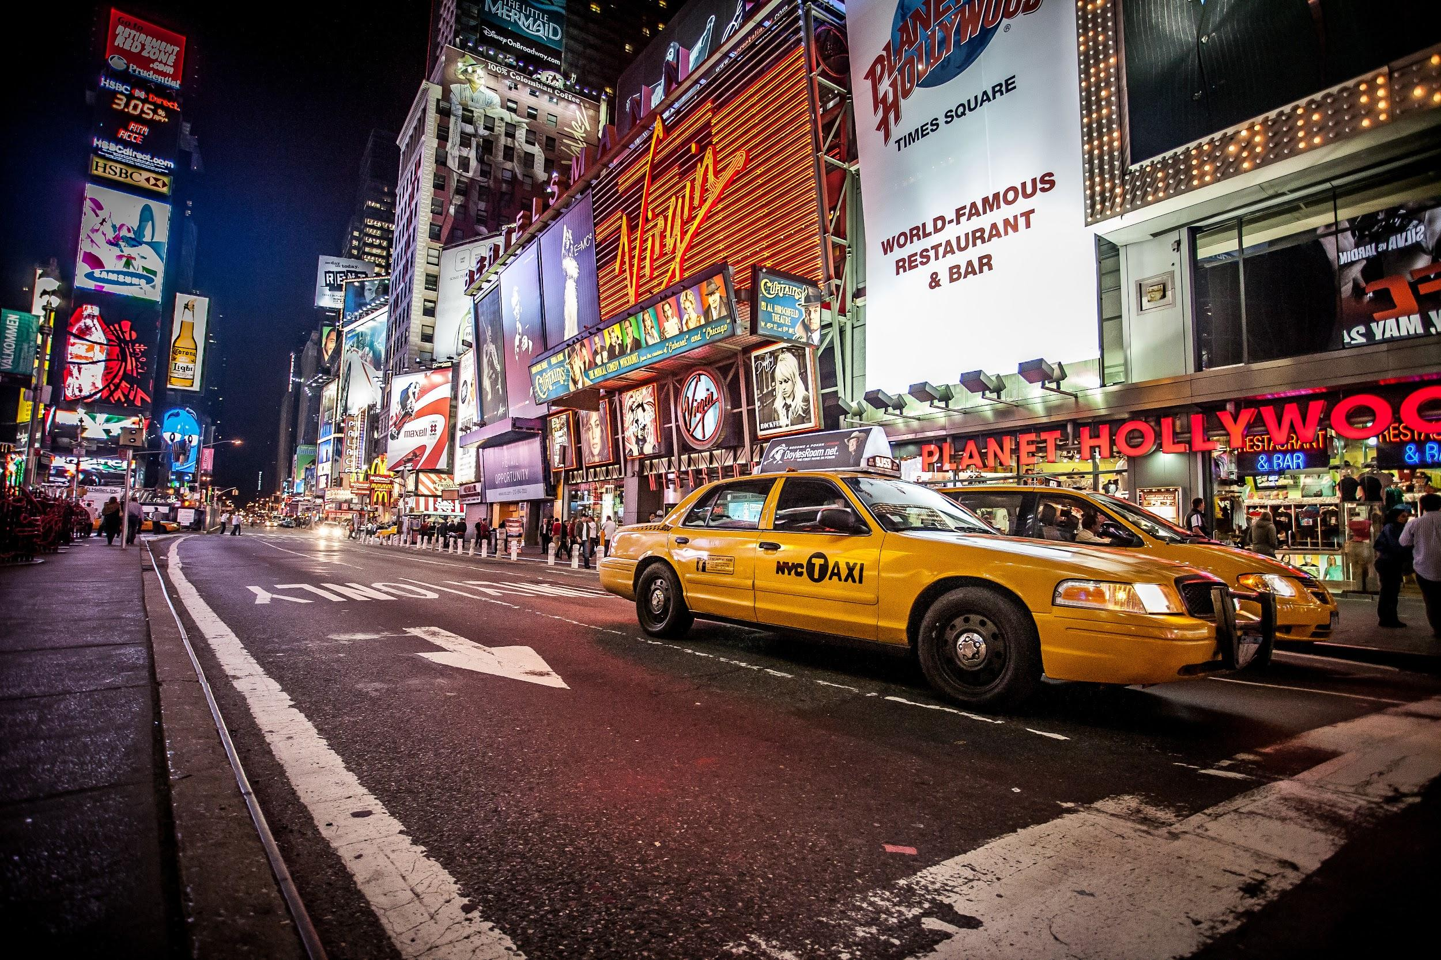
NYC
TAXI
We are trying to find strategies
- to help out NYC yellow cab drivers to make more profits
ZYMIC
Zheng Chai, Yuan-Yao Chang, Michael Chon, Chong Zhang

Slide 2
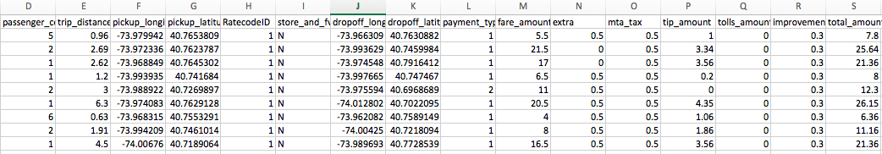
The Dataset
Where? – https://s3.amazonaws.com/nyc-tlc/trip+data
Format? – csv (comma separated value)
Size? – Approximately 2GB per csv and used 12 csv files
Attributes? – 19 columns “distance, pickup_longitude, pickup_latitude, dropoff_longitude, dropoff_latitude, tpep_pickup_date, mta_tax” and etc.
Rows? – Approximately 12 million rows per 1 csv file
Each row represents one single trip made by a NYC yellow cab

Slide 3
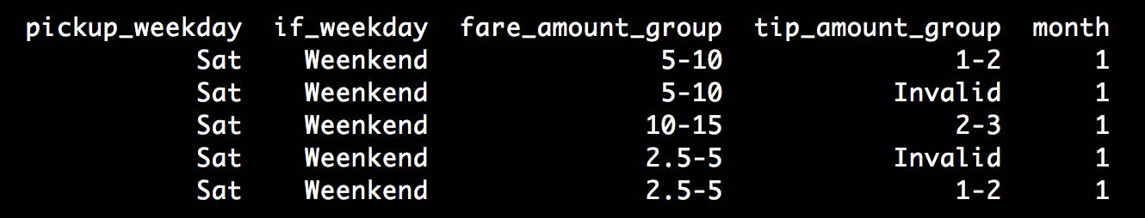
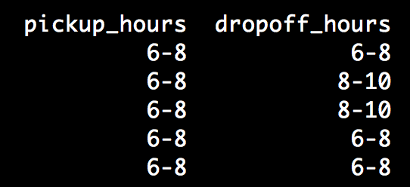
Data Cleaning
Methods
Deleted: Store_and_fwd_flag, VendorID, etc.
Errors: -the total_fare_amount is less than $2.50 -pickup and dropoff latitude and longitude is the same
Spark, SparkSQL, Python, AWS
Cluster size: 1 master 2 cores 4 tasks
Time Spent Data Preparation Locally: 9 hours for the data AWS: 2 hours for the data
Time Spent Analyzing: Locally: 4 hours
New Attributes
The cleaned dataset
Fare_group
$2.50 - $5 =>1 , $5 - $10 =>2, $15 - $20 => 3, ..
Tip_group
$0 - $1 =>1, $1 - $2 =>2, $2 - $3 =>3, …
>$20, invalid
if_weekday
Weekday or Weekend

Slide 4
Goals
What are the best hours for NYC yellow cab drivers to pick up customers?
Which months are profitable for NYC yellow cab drivers?
What are the top five pick-up locations?
What time/day does tips/pick-ups occur the most?
Literature Review
“How does taxi driver behavior impact their profits? Discerning the real driving from large scale GPS traces?” - Teerayut Horanont, Thananut Phiboonbanakit from Sirindhorn International Institute of Technology
The conclusion: “The highest chance to get customers is in the weekday rush hours between 7am and 10am and at the midnight for the weekend. The increased profits were mainly based on the distance. Finally, the hotspot of taxicabs destinations can be observed at the interchange of major public transportation. These results uncover taxi driving behavior on one of the densest network in Bangkok and yields great benefit for both taxi drivers and passengers.”

Slide 5
Findings:
Total Tip frequency vs Pickup(fare) frequency by every 2-hour
Total Tip sum vs Fare sum by every 2-hour
Notes:
On Sat and Sun, many pickups and tips occur in 0-2 time period (0:00-2:00AM) due to nightlife in NYC
On weekdays, many pickups and tips occur in 6-10 (6:00-10:00 AM) and 18-20 (6:00-8:00 PM) due to rush hour
On Thursday, tips occur the most during 20-22 (8:00-10:00 PM)
On Friday, pickups occur the most during 18-20 (6:00-8:00 PM)
Customers tend to pay more tips on Thursday night around 10:00 - 12:00 PM
The total fare amounts are greater on Friday than Thursday because of more taxi rides on Friday.

Slide 6
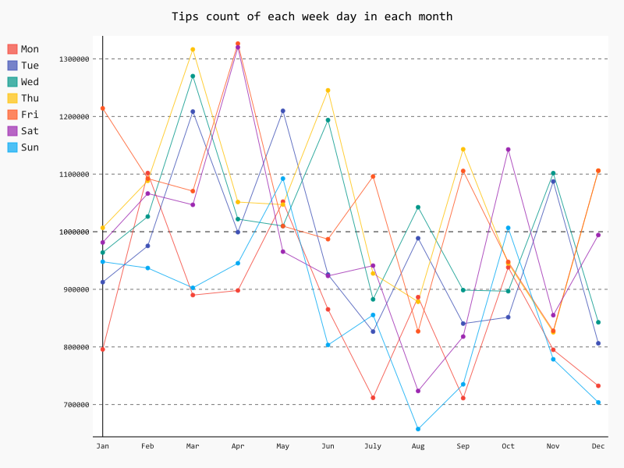
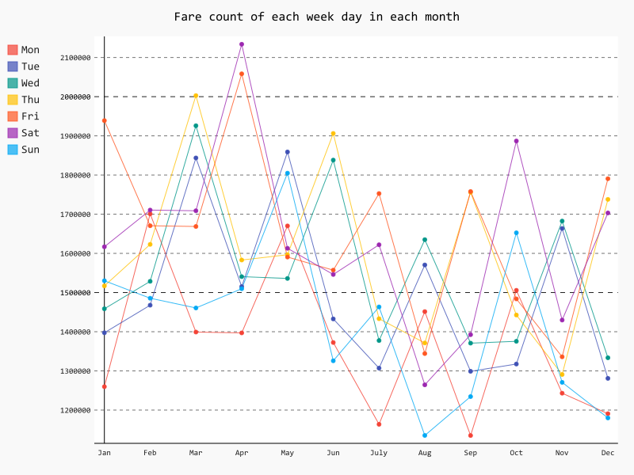
Findings:
Total Tip vs Total fare frequency by each month
For Sat and Sun, August is surprisingly low in terms of the number of pickups even though we assumed that summer is the busiest season for taxi drivers
For Fri and Sat, April is extremely high in terms of the number of pickups
For Thurs, March is relatively high in terms of the number of pickups

Slide 7
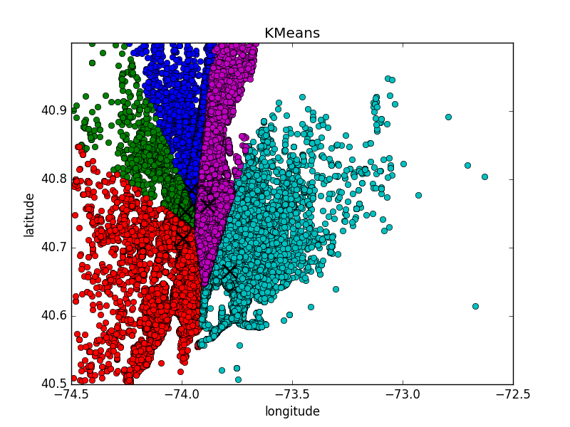
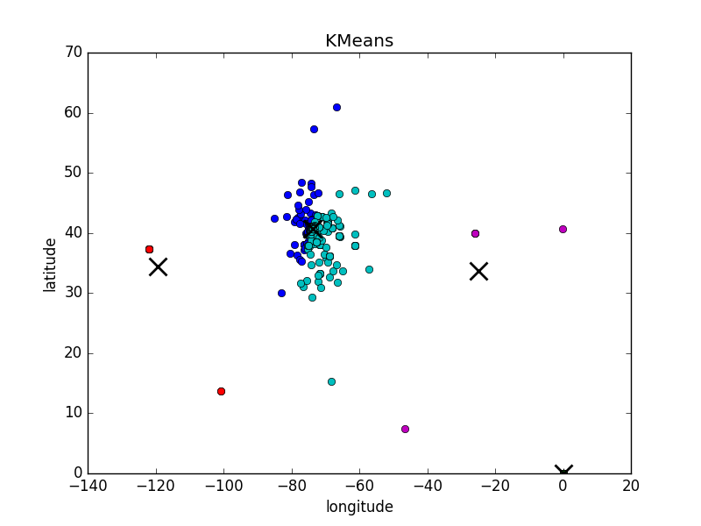
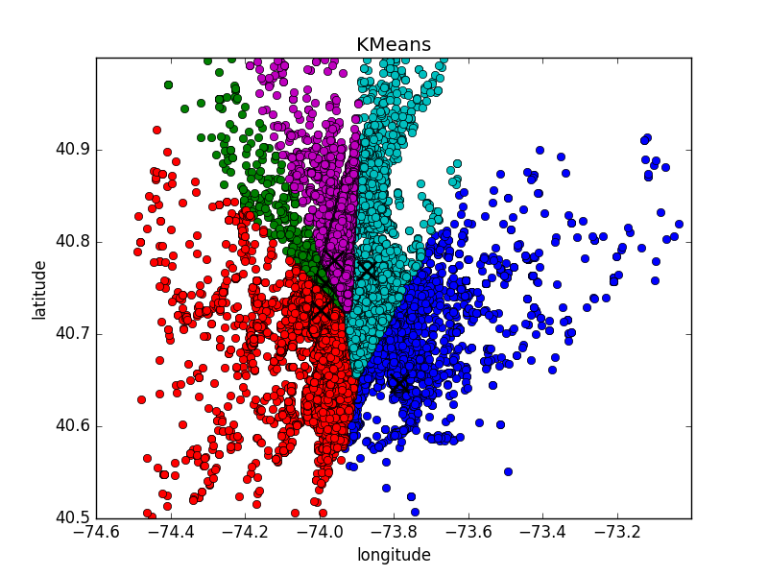
K-means clustering, K = 5
DROP-OFF
Before cleaning (Not in NYC)
PICK-UP
Notes:
No outliers

Slide 8
5 Centroids for Pick-up
5 Centroids for Drop-off
JFK airport
LGA airport
SoHo in Downtown
Time Square in Midtown
Metropolitan Museum in Uptown
K = 1 to 20
Cooper Hewitt Smithsonian Design Museum (5 Ave & E 91st)
Bryant Park (42nd St & 5th Ave)
94b E Broadway (Near Chinatown)
Holiday Inn Express New York around JFK airport
Gorman Playground (3 blocks away from LGA)

Slide 9
Friday - most profitable day in a week (Jan - June)
Top 5 pickup in Friday for July – Dec

Slide 10
Heatmap on Friday
Closer Look
Jan- June

Slide 11
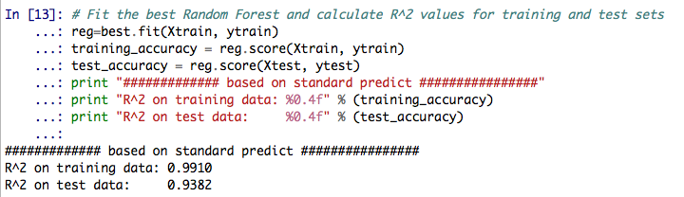
Why Random Forest?
According to Wikipedia, it is one of the most accurate learning algorithms.
Random Forest Algorithm fully utilizes the datasets, and it estimates what variables are important in the classification.
Our Random Forest Model has a training accuracy of 0.9918, and a test accuracy of 0.9382.

Slide 12
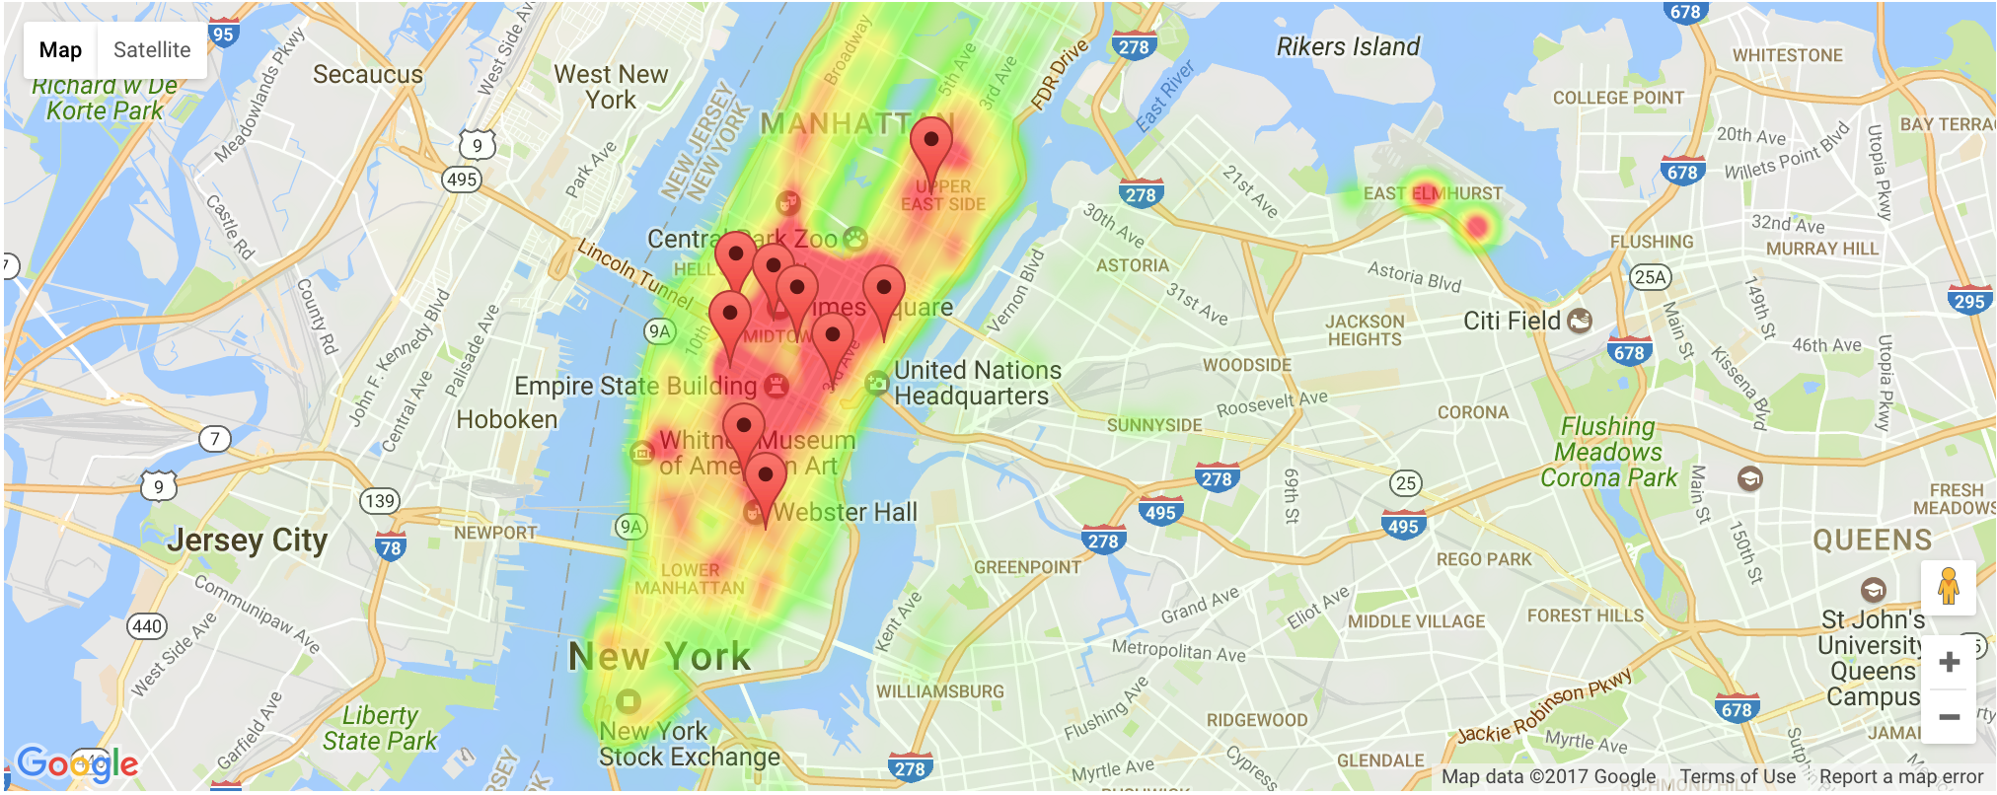
Heat map on predicted Friday pick-up by every 4 hour
Heat map on the entire predicted Friday
What if we expand the prediction to whole week?

Slide 13
Conclusion
1.
Thurs | Fri | Sat
10:00 AM - 12:00 AM | 10:00 AM - 2:00 AM (SAT) | 2:00 PM - 12:00 AM
2.
Thurs | Fri | Sat
Feb - March May - June Aug - Sep Nov - Dec | Mar - Apr Aug - Sep Nov - Jan | Mar - Apr Aug - Sep Nov - Jan
3.
The top five pick up locations are:
1) Upper East Side South, 2) Midtown Center, 3) Penn Station/Madison Square West, 4) Upper East Side North, 5) Midtown East
4.
We can use Random Forest model to predict future hot spots

Slide 14




What would we have done if we had more time?
Stochastic Simulation: We could have used the model would be to do a Monte Carlo simulation of taxis driving around the city, and then we could see if our virtual taxi can get or not get the fares.
Routes: We could have optimized various routes to maximize profits.
Datasets: We could have used other datasets such as Green Taxi and Uber or even weather data to compare and find competitive strategies.
Zheng Chai
Yuan-Yao Chang
zc104@georgetown.edu
yc704@georgetown.edu
Michael Chon
Chong Zhang
mc2153@georgetown.edu
cz211@georgetown.edu

